Slide 1
Stronger Together: A Strategic Skills Partnership for Nuclear

Slide 2
NSSG Mission
The NSSG brings together our nuclear sector, to collaborate on common skills challenges. Using an evidence-based approach, we identify the key skills risks and develop effective prioritised interventions designed to mitigate critical skills gaps.

Slide 3
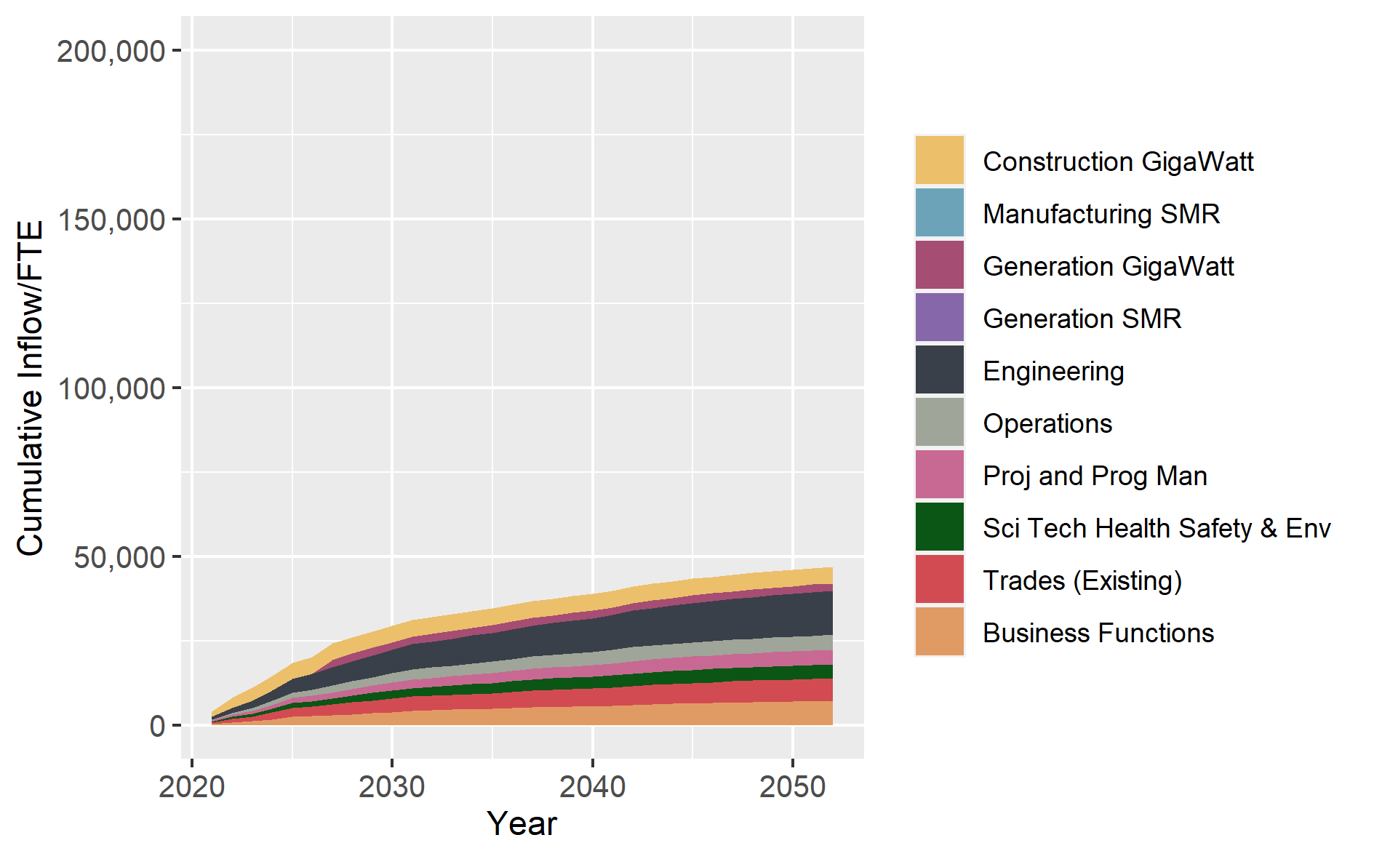
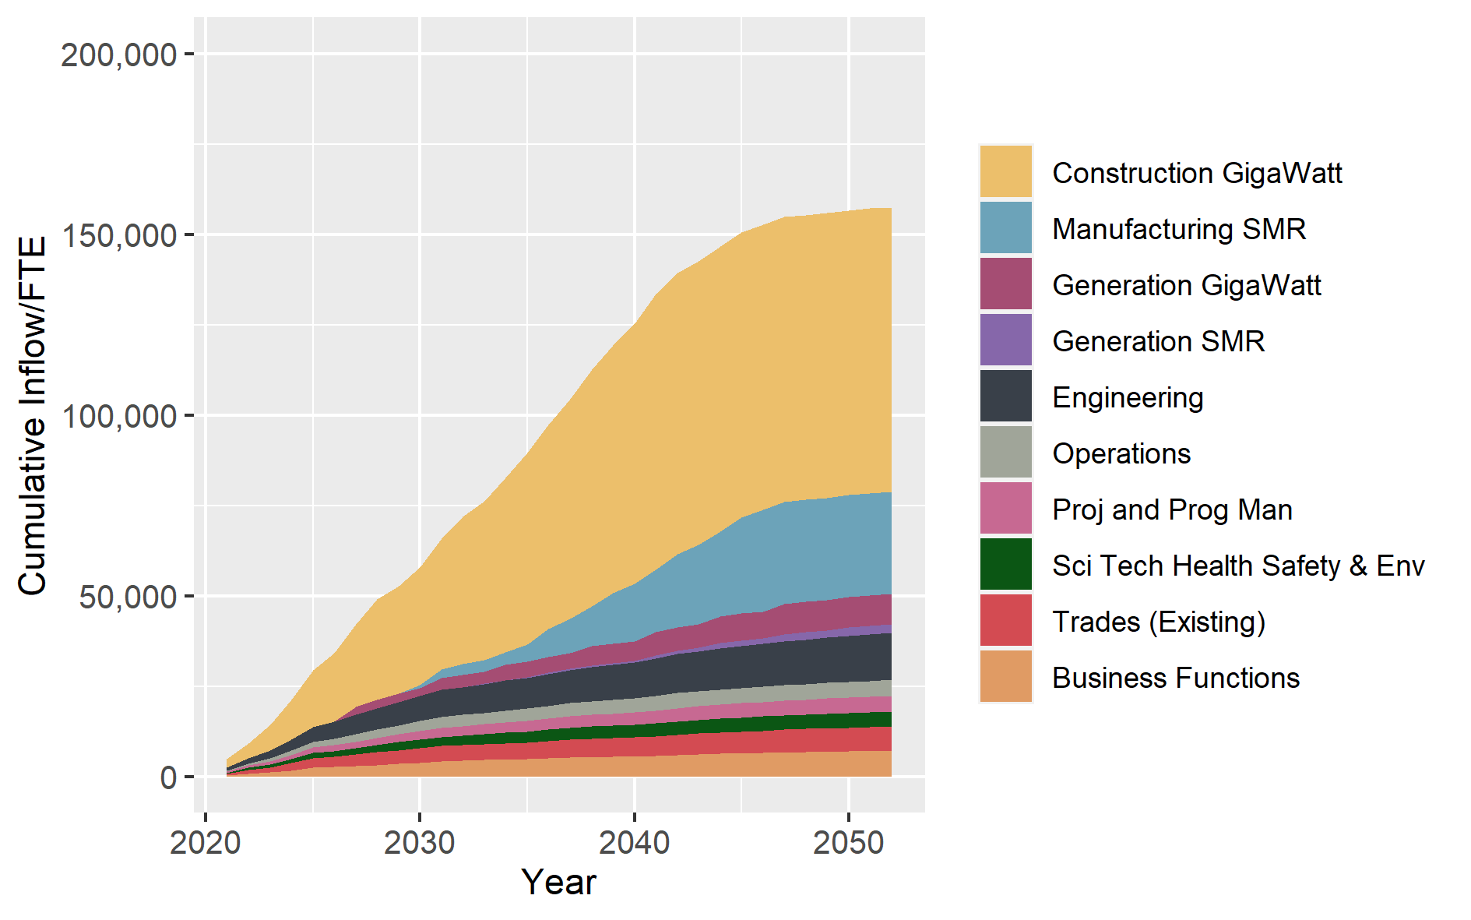
The Scale of the Skills Challenge
A conservative view of civil(24 GWE) and defence skills requirements
Today
Recruitment increase by at least 300% to meet the ambitions of civil (25GWe) and defence programme by 2050
Notes:
We are confident that this is at best an optimistic view of our minimum future requirements
The capability and capacity are a non-negotiable for defence, we need to use our resources in a smarter more efficient way to tackle the key skills challenges.

Slide 4
Key Skills Challenges
Critical Skills Gaps
Sector Attractiveness
Competition for Talent
Mobility of Labour
Lack of Standardisation
Workforce Diversity
Notes:
These issues can only be tackled by cross-sector, collaborative action via a well-informed, connected and leading voice on skills

Slide 5
Sector Collaboration
NSSB
Major Employers
Government Dept
Operational Delivery
Employers
Enablers/Providers
Notes:
A unified and agile skills system with direct Links to all client organisations across nuclear life cycle in Civil and Defence as well as to government departments associated with skills for nuclear
NSSB
•Sets the priority actions required (evidence based)
•Establishes a programme of activity, supported by Strategic Support Service
Enabling Forum / Operational Delivery (made up of wider employers and providers) Turns insight (strategy, policy and market intelligence) into a manageable programme of risk mitigation activities.
•Feed into the evidence base by providing supply information and data associated with the skills risk.
•Monitor progress of Programme of Activity and escalates issues/risk to NSSB
•Establish task and finish groups (Sponsored by NSSB member)

Slide 6
Our Approach
Insight led – Labour Market Intelligence
Interventions via Task & Finish Groups
Industry Collaboration
Enabling Activity
Notes:
NSSG takes an insight led approach to skills planning, using the latest LMI to identify, evaluate and prioritise significant skills risks, developing effective skills interventions designed to mitigate.
Developing interventions collaboratively where it makes sense to do so.
Pooling investment, provides greater efficiency, greater economies of scale, and greater standardisation
Adopting robust Programme Management Principles to monitor progress

Slide 7
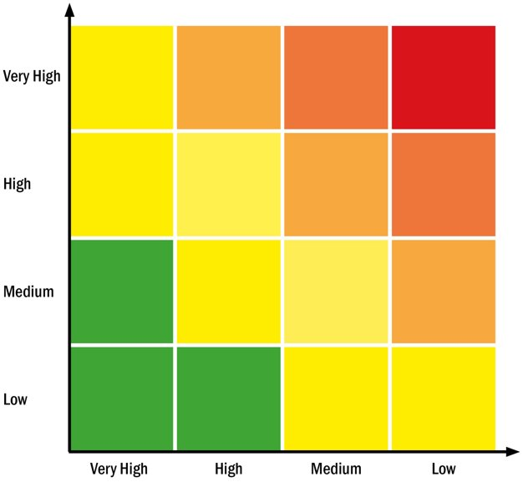
Labour Market Intelligence
Nuclear Workforce Assessment provides a single, comprehensive dataset detailing workforce demographics
Skills risk ‘heat maps’ compare the critical demand for a skill against the market availability for job roles across both civil & defence
Where there are common skills risks these form a priority risk log
Priority risks are met through Task and Finish Group interventions
Nuclear Engineers
Systems Engineers
Welders
Skills Demand
Market Availability
Notes:
NWA in here -
Labour Market Intelligene provides insight for:
HMG decision making
Production of Skills Heat Maps
Scenario Modelling for future workforce requirements
Insight in relation to skills supply challenges in the nuclear sector

Slide 8
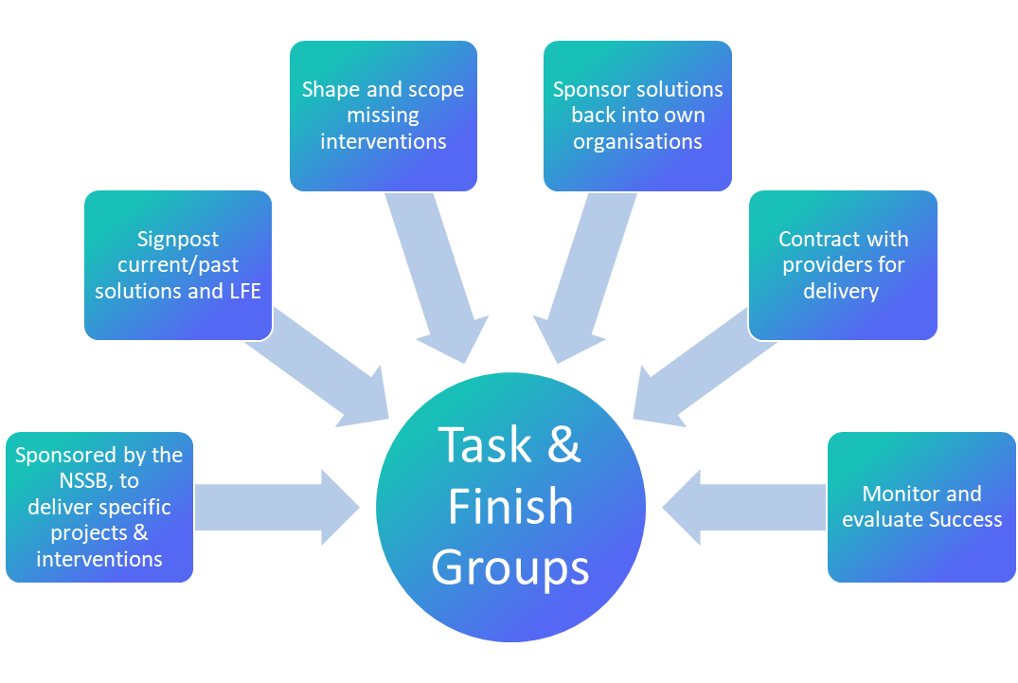
Agile Task & Finish Groups

Slide 9
Enabling Activity
Exciting the next generation – ( including Nuclear curriculum material to 6K+ schools)
Early careers pipeline development
Standards and vocational education
Training capacity exploitation
Workforce mobility and careers pathways
Promotion of nuclear as a destination of choice – diverse and inclusive
Co-ordinated response on skills policy

Slide 10
Provider Capacity/Capability Review
Project Outline: To understand the current capacity of existing nuclear skills provision against demand and the barriers to the upscaling of provision to meet increasing demand. Specifically, the identification and understanding of:
Duplication of effort and spare capacity
Planned and aspirational increases in C&C
The geographical spread of C&C
The required C&C to support current and future programmes
Shortfalls in planned C&C to meet current and future programmes
Recommendations to support future investment to grow/optimise C&C

